Slide 1
Monthly Reporting Meeting
June 2021

Slide 2
May 2021 Email Results
2021
Email Marketing

Slide 3
2021
Email Marketing: May 2021 vs. 2019
Up 24%
*Excludes new acquisitions and HG Nissan. We also sent out 288 campaigns in May 2021 vs. 250 in May 2019.

Slide 4
2021
Email Marketing: May 2021 vs. 2019
Up 33%
*OR increased from 22% in 2019 to 24% in 2021.

Slide 5
2021
Email Marketing: May 2021 vs. 2019
Up 32%
*CTO was flat at 14%.

Slide 6
Memorial Day Emails
2021
Email Marketing

Slide 7
2021
Email Case Study: Memorial Day
On 5/27, we launched Memorial Day group emails for the Hall, Heritage, and MotorWorld divisions
Purpose:
To identify customers’ interest in our brands
To test CTA button copy

Slide 8
2021
Email Case Study: Memorial Day
Results:
Implications:
Leverage divisional insights pertaining to brand affinity in various communications including newsletters.
Develop future drip campaigns based on customers’ click behavior.
Pay close attention to CTA copy and conduct additional tests.
Don’t sell in the email. Sell on the landing page.
Hall & Heritage: OR: 20%; CTO:10%
MotorWorld: OR: 28%; CTO: 16%
CTA Button Live Optimization:
Shop XX Brands
View XX Brands
Hall: 302% lift
Heritage: 66% lift
MW: 30% lift
Highest CTR Brands
Toyota
Honda
Jeep
Ford (Hall)
Chevy (HTG & Hall)
Lexus (MW)
MB (MW)
Lowest CTR Brands
Chrysler
Buick (HTG)
Genesis
Dodge
Mitsubishi (MW)
Nissan (Hall)
RAM

Slide 9
Long Scroll Oil Change
2021
Email Marketing

Slide 10
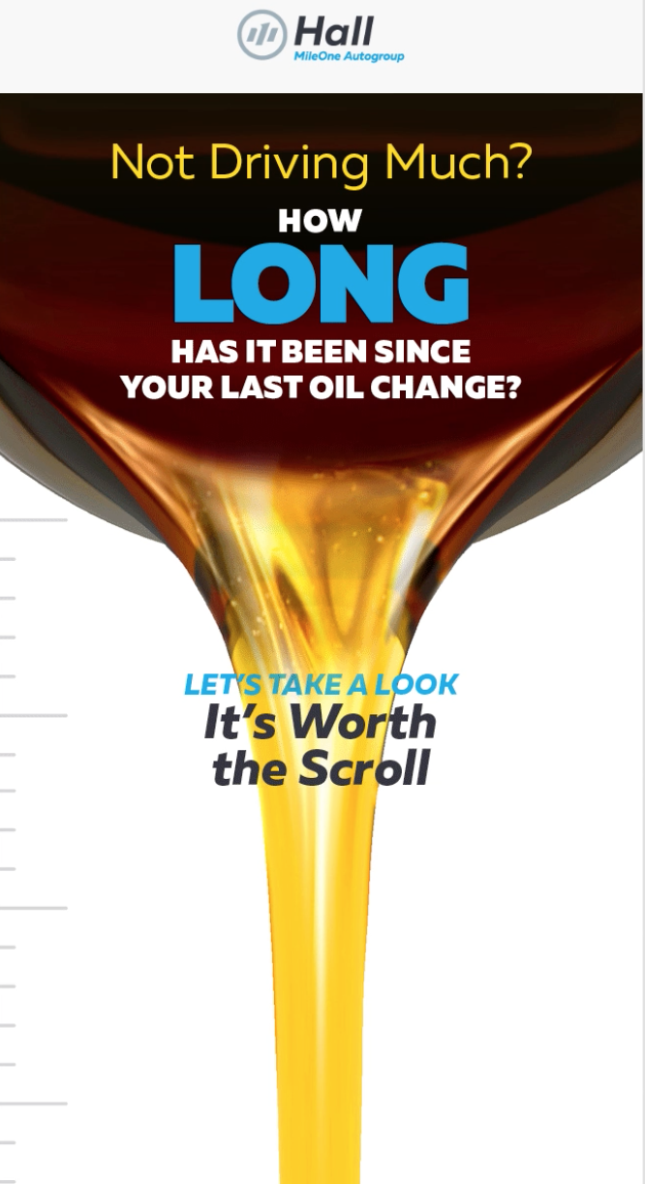
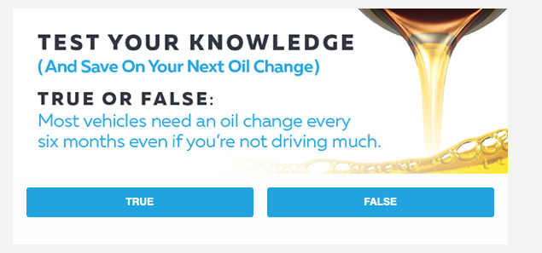
2021
Email Case Study: Long Scroll Oil Change
On 4/15, a long scroll campaign was deployed to 79k customers without a service visit in the past 6 month (longer for certain brands). A poll was also included in April’s newsletters
Purpose:
To educate consumers regarding time-based oil change requirements vs. mileage-based
To gauge performance of a long-form email

Slide 11
2021
Email Case Study: Long Scroll Oil Change
Implications:
Test additional campaigns featuring the long-scroll format
Build long-scroll campaigns into customer lifecycle communications
Results:
Division | OR | CTO | RO Counts | RO Rate
Hall | 17% | 18% | 1,548 | 6.6%
Heritage | 22% | 17% | 1,413 | 6.5%
MotorWorld | 26% | 20% | 263 | 4.3%
Silver Spring | 27% | 14% | 904 | 5.1%
Division | Awareness
Hall | 66%
Heritage | 62%
MotorWorld | 62%
Silver Spring | 66%
Subaru, Honda, Toyota, Mazda, & Acura overperformed (% of ROs vs % list composition)
Nissan, Ford, CDJR, Hyundai, MB, & BMW underperfomed

Slide 12
Mazda Service Segments
2021
Email Marketing

Slide 13
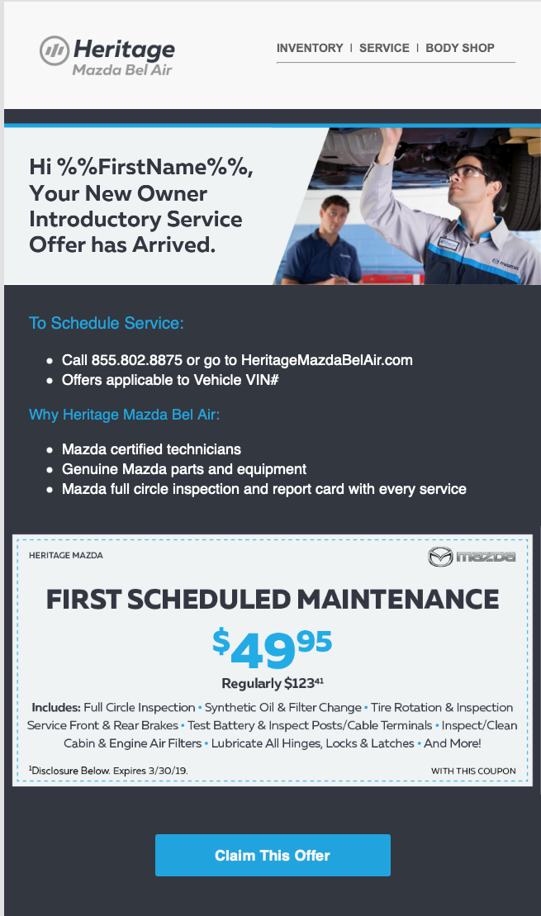
2021
Email Case Study: Mazda Service Segments
On 6/17, we tested a new version of New Owner Service Offer email for Mazda Bel Air against the the existing creative for Mazda Catonsville and Mazda Bel Air
Purpose:
To determine if the new creative provides a lift and if creative for remaining segments should be updated
To determine impact of creative on retention

Slide 14
2021
Email Case Study: Mazda Service Segments
Implications:
Change the format of all remaining segments to match Mazda Bel Air’s new customer email
Look for opportunities to incorporate reveal functionality in other communications
Results:
Dealership | April CTO
Mazda Bel Air | 9%
Mazda Catonsville | 4%
Mazda Towson | 12%
Dealership | April | May CTO | June CTO
Mazda Bel Air | 9% | 46% | 65%
Mazda Catonsville | 4% | 11% | 9%
Mazda Towson | 12% | 10% | 18%
Click through rates have consistently been around 8-10% since 2019 and never higher than 9% for Mazda Bel Air

Slide 15
2021
June 2021 Email Marketing: Next Steps
Continue to improve open rates through subject line testing in June
Continue 7 – 9 AM deployments
Update the Mazda retention emails and explore opportunities for incorporating reveal functionality elsewhere
Look for opportunities for drip campaigns

