Slide 1
Month XX, 2025
MotorWorld Relocation Proposal for
Toyota Motor Corporation

Slide 2
Relocation Proposal
A New MotorWorld:
Unsurpassed
&
Visibility
Store Exterior Concept 3
Why Relocate 4 - 6
Traffic 7 - 8
Site Plan & Facility 9 - 11
Before & After 12 - 21
Accessibility.

Slide 3
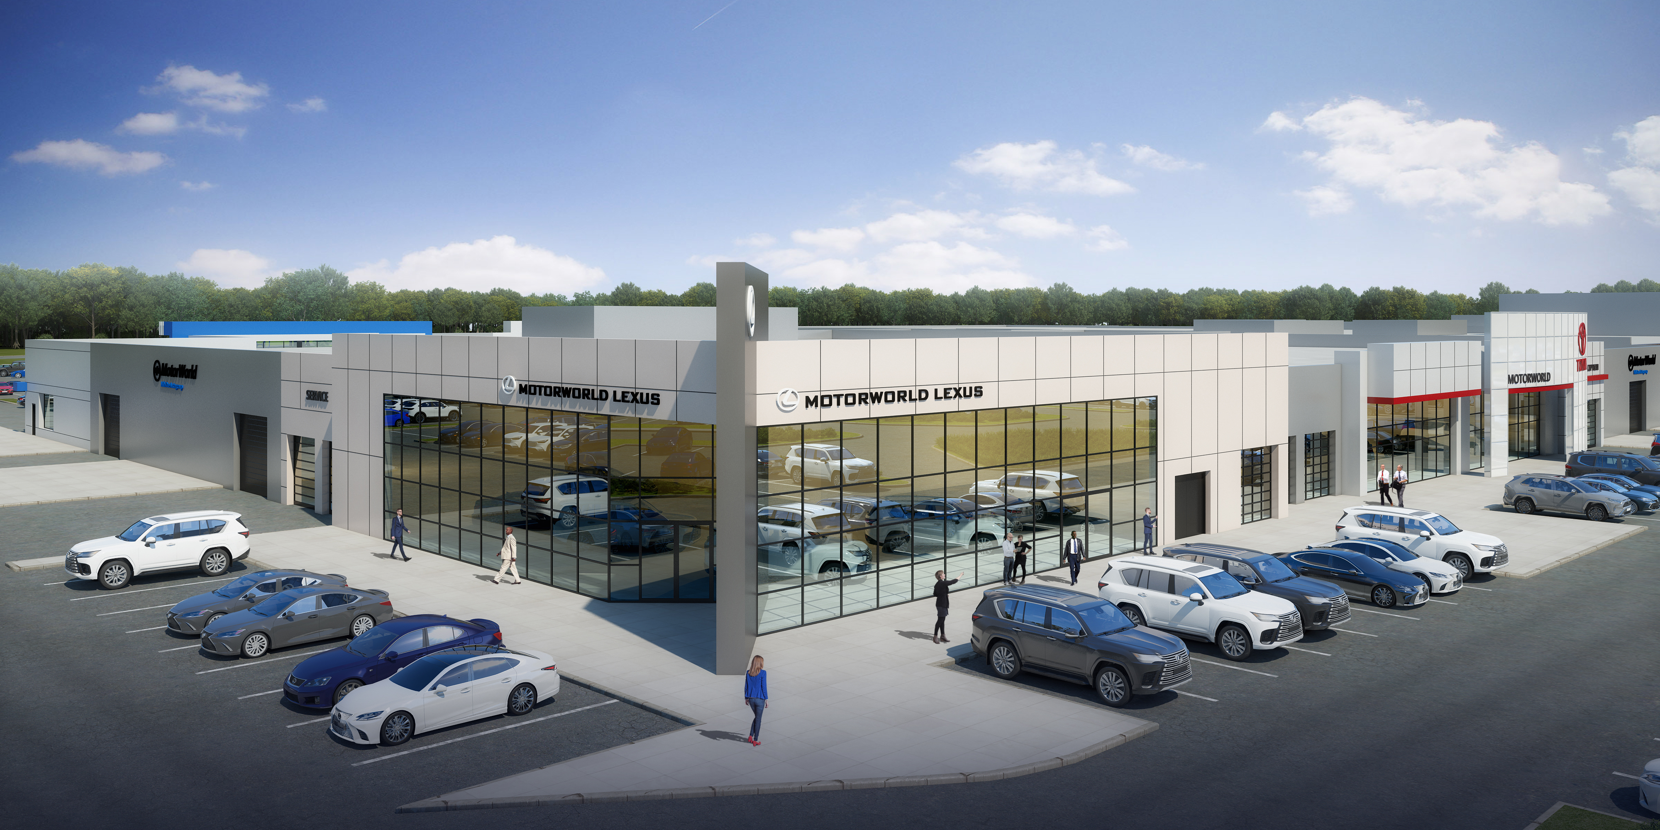
Store Exterior Concept

Slide 4
Why Relocate?
A Smart Move.
MotorWorld’s redevelopment initiative is an innovative plan to construct modern automotive sales and service operations at an existing regional retail hub.
This bold approach offers MotorWorld ownership of its facilities, while breathing new life into a once vibrant retail center. With MotorWorld poised to be at the center of the community’s retail core, our customers will enjoy an even better car buying and servicing experience at a more convenient location.

Slide 5
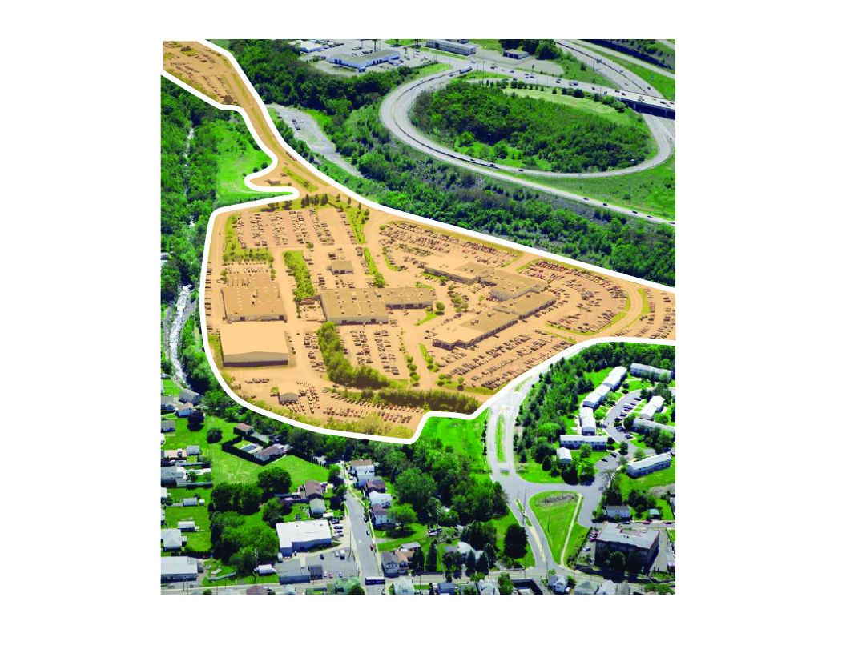
Why Relocate?
Where We Are Now: 150 MotorWorld Drive, Wilkes-Barre, PA
> Lack of street presence and appeal
> MileOne Leases its site from a 3rd party, creating higher occupancy
costs and restricting flexibility
> Need additional 70,000 square feet of service capacity & service lanes
> Building a new service facility is expected to cost $15 million
> Not ideal layout, all showrooms are accessible by the public from the inside
> On-site traffic and security concerns
> Additional space needed for administrative offices
> Aging facility with many items in need of updating or modernizing
Notes:
Pros Cons

Slide 6
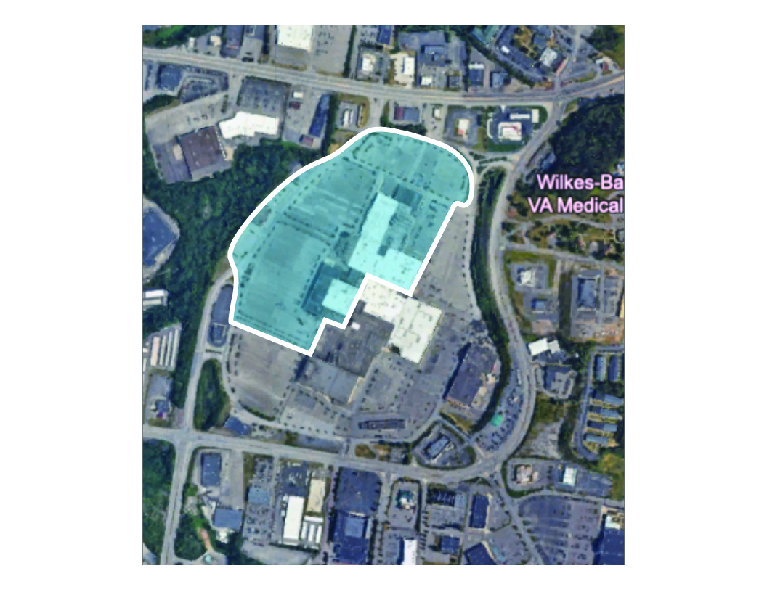
Why Relocate?
We Propose to Relocate to: 29 Wyoming Valley Mall, Wilkes-Barre, PA
> More visibility and accessibility than ever before
> Beautiful new build stand-alone storefronts and showrooms
> Opportunity to own the real estate to achieve greater flexibility
> Surrounded by dense retail
> Significant additional square footage to service all of our brands efficiently
> Better overall experience for our customers and employees
> Convenient location accessible from all main roads in the area
> New access road to be built for exclusive dealership entrance and exit

Slide 7
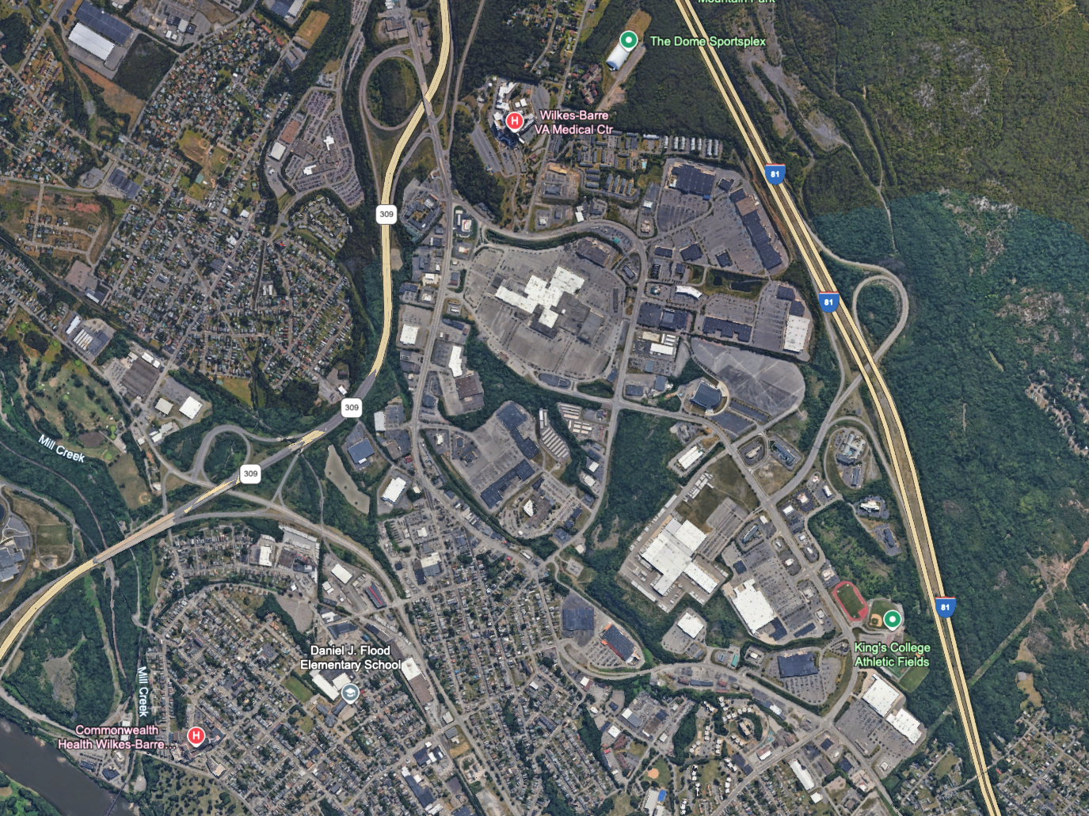
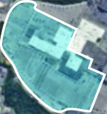
Why Relocate?
To Mohegan Sun Casino
The Dome Sportsplex
Dense Retail —
Increased Traffic from Surrounding Retail Area
VA Medical Center
Retail/Restaurants
WB Township Commons
Wyoming Valley Mall
Retail/Restaurants
Residential
Mohegan Sun Arena
Retail/Restaurants
East End Center
Retail/Restaurants

Slide 8
Why Relocate?
Olive Garden
Barnes & Noble
PetSmart
Regional Retail Hub
Right at the Center of
Wilkes-Barre
Longhorn Steak House
Men’s Wearhouse
European Wax Center
VisionWorks
Starbucks
Petco
Wyoming Valley Mall
Wyoming Valley Mall
Famous Footwear
Target
Ross Dress For Less
Hobby Lobby
McDonalds
Grotto’s Pizza
Dollar General
La-Z-Boy
Mirakuya Japanese Restaurant
La Tolteca
Gallery of Sound

Slide 9
Site Plan & Facility

Slide 11
Lexus
XX,XXXsf
Notes:
Need updated image, rather than site plan

Slide 12
Before vs After

Slide 13
Property Access
Before
> One Access Point
> Limited Street Presence
> Limited Visibility
After
> Major Street Presence
> Easy Access From Every Direction
> Retail Environment
= Access Point

Slide 14
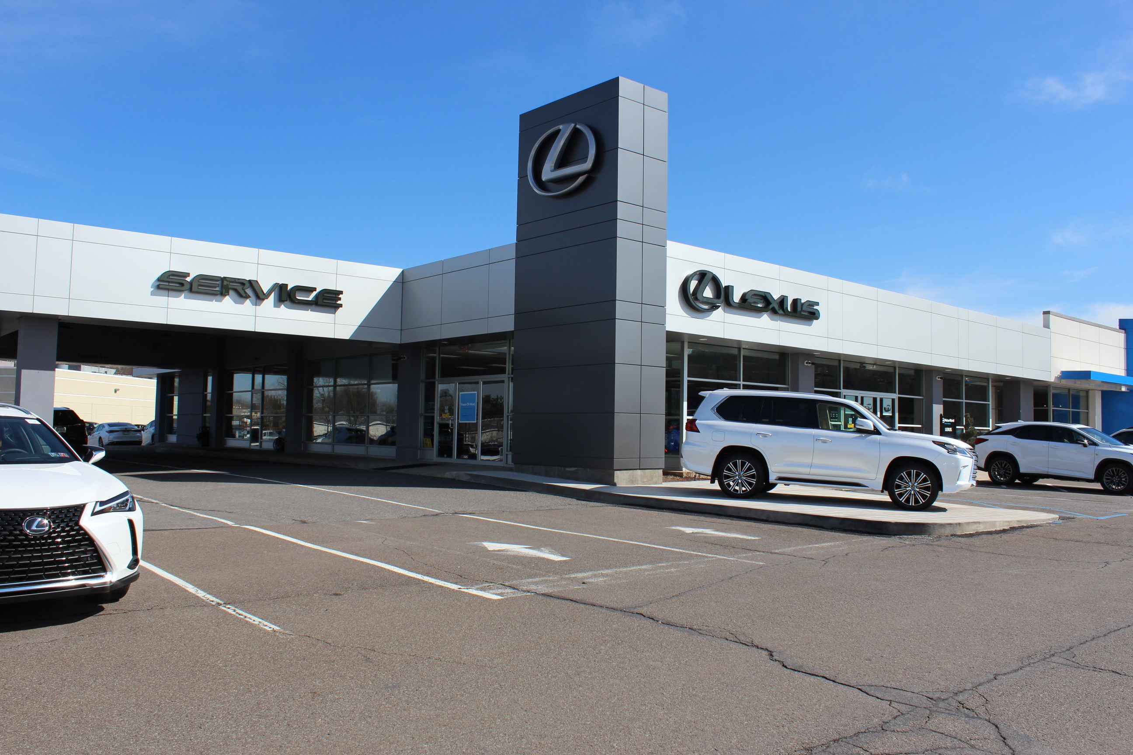
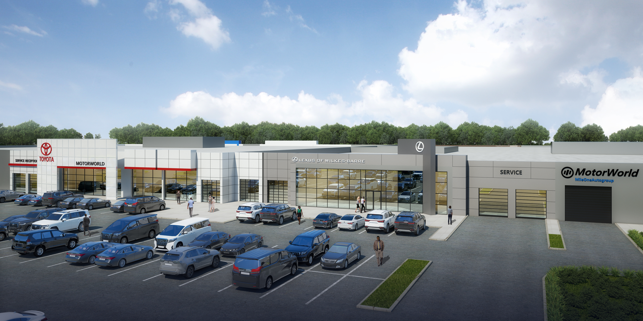
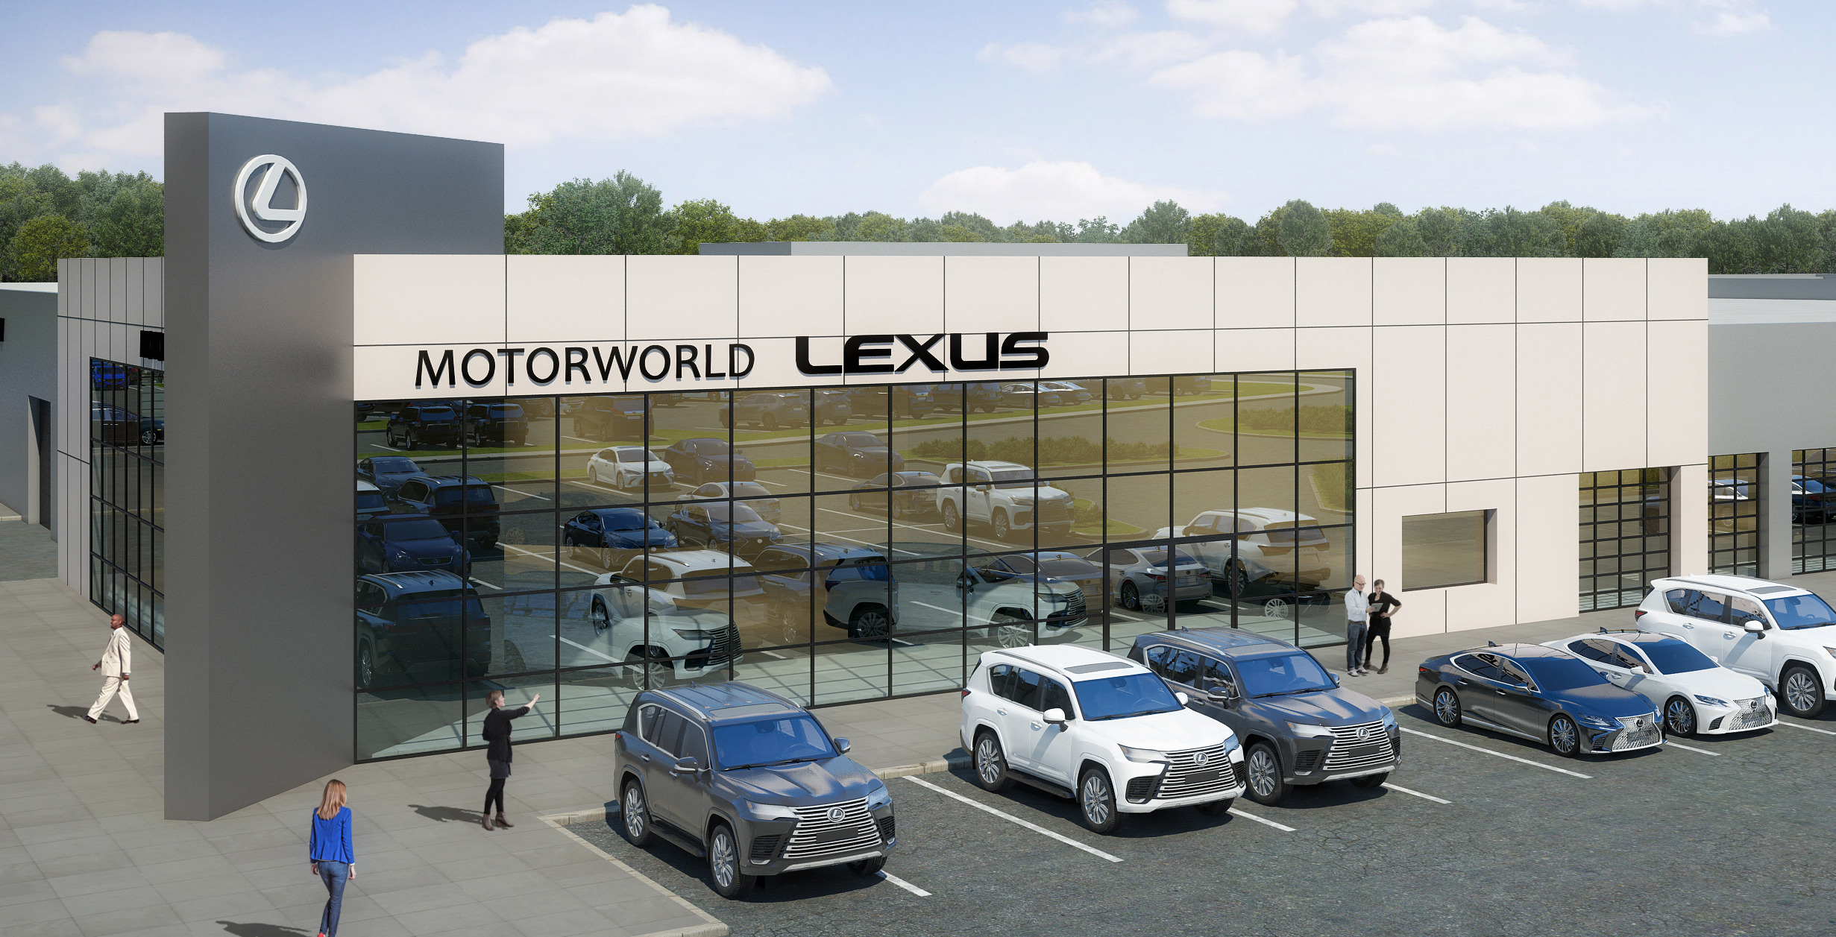
Sales Façade Lexus
Before
After
> Updated Exterior
> Spacious New Showroom
> Easy Access for Customers
Notes:
Need new sales facade to match logo from new rendering

Slide 15
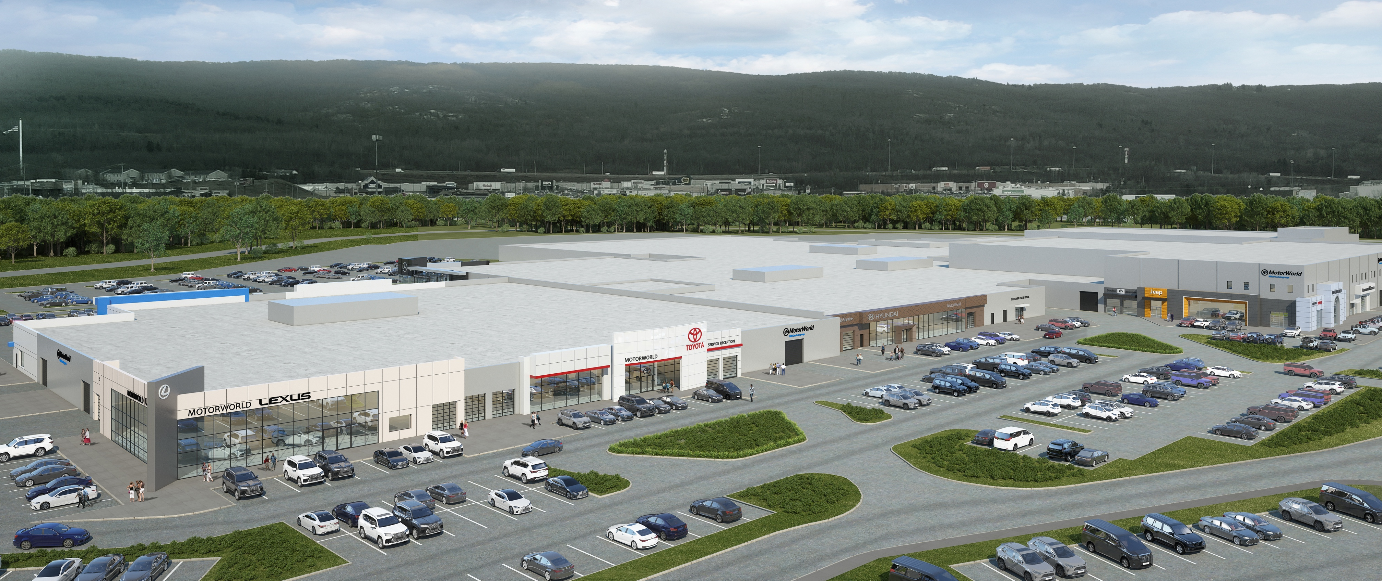
Property Concept Proposed
Lexus
Toyota
Notes:
Building logo doesn’t match logo from new Rendering

Slide 16
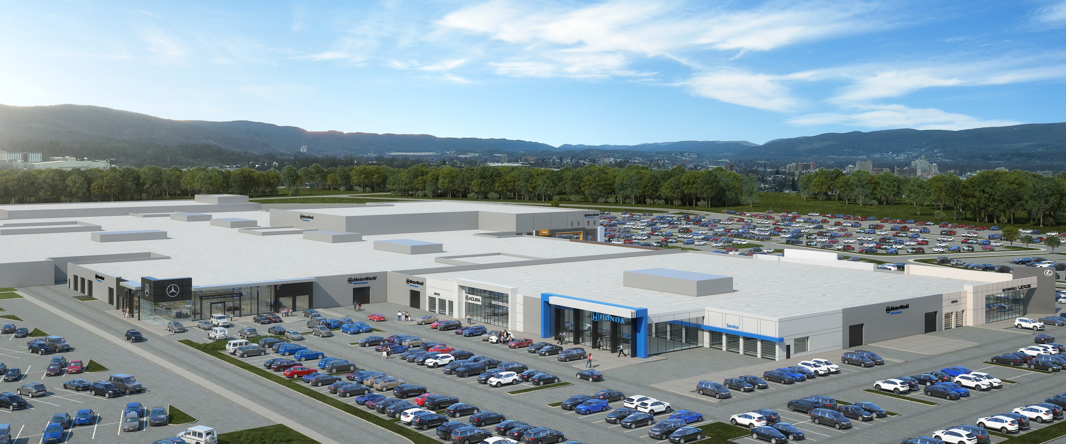
Property Concept Proposed
Mercedes-Benz
Acura
Honda
Notes:
Building logo doesn’t match logo from new Rendering

Slide 17
Sales Floorplan Current
Before
Sales
Limited Space in Showroom to Display Vehicles >
Limited Space for Sales Advisors >
Shared Spaces with F&I >
Notes:
Photo looks the same??

Slide 18
Sales Floorplan Proposed
After
Sales
Spacious Showroom >
Additional Space for Sales Advisors >
Dedicated Service Reception >
Dedicated Space for Service Advisors >
Sales & Service Lounge >
Dedicated F&I Space >
Vehicle Delivery Area >

Slide 19
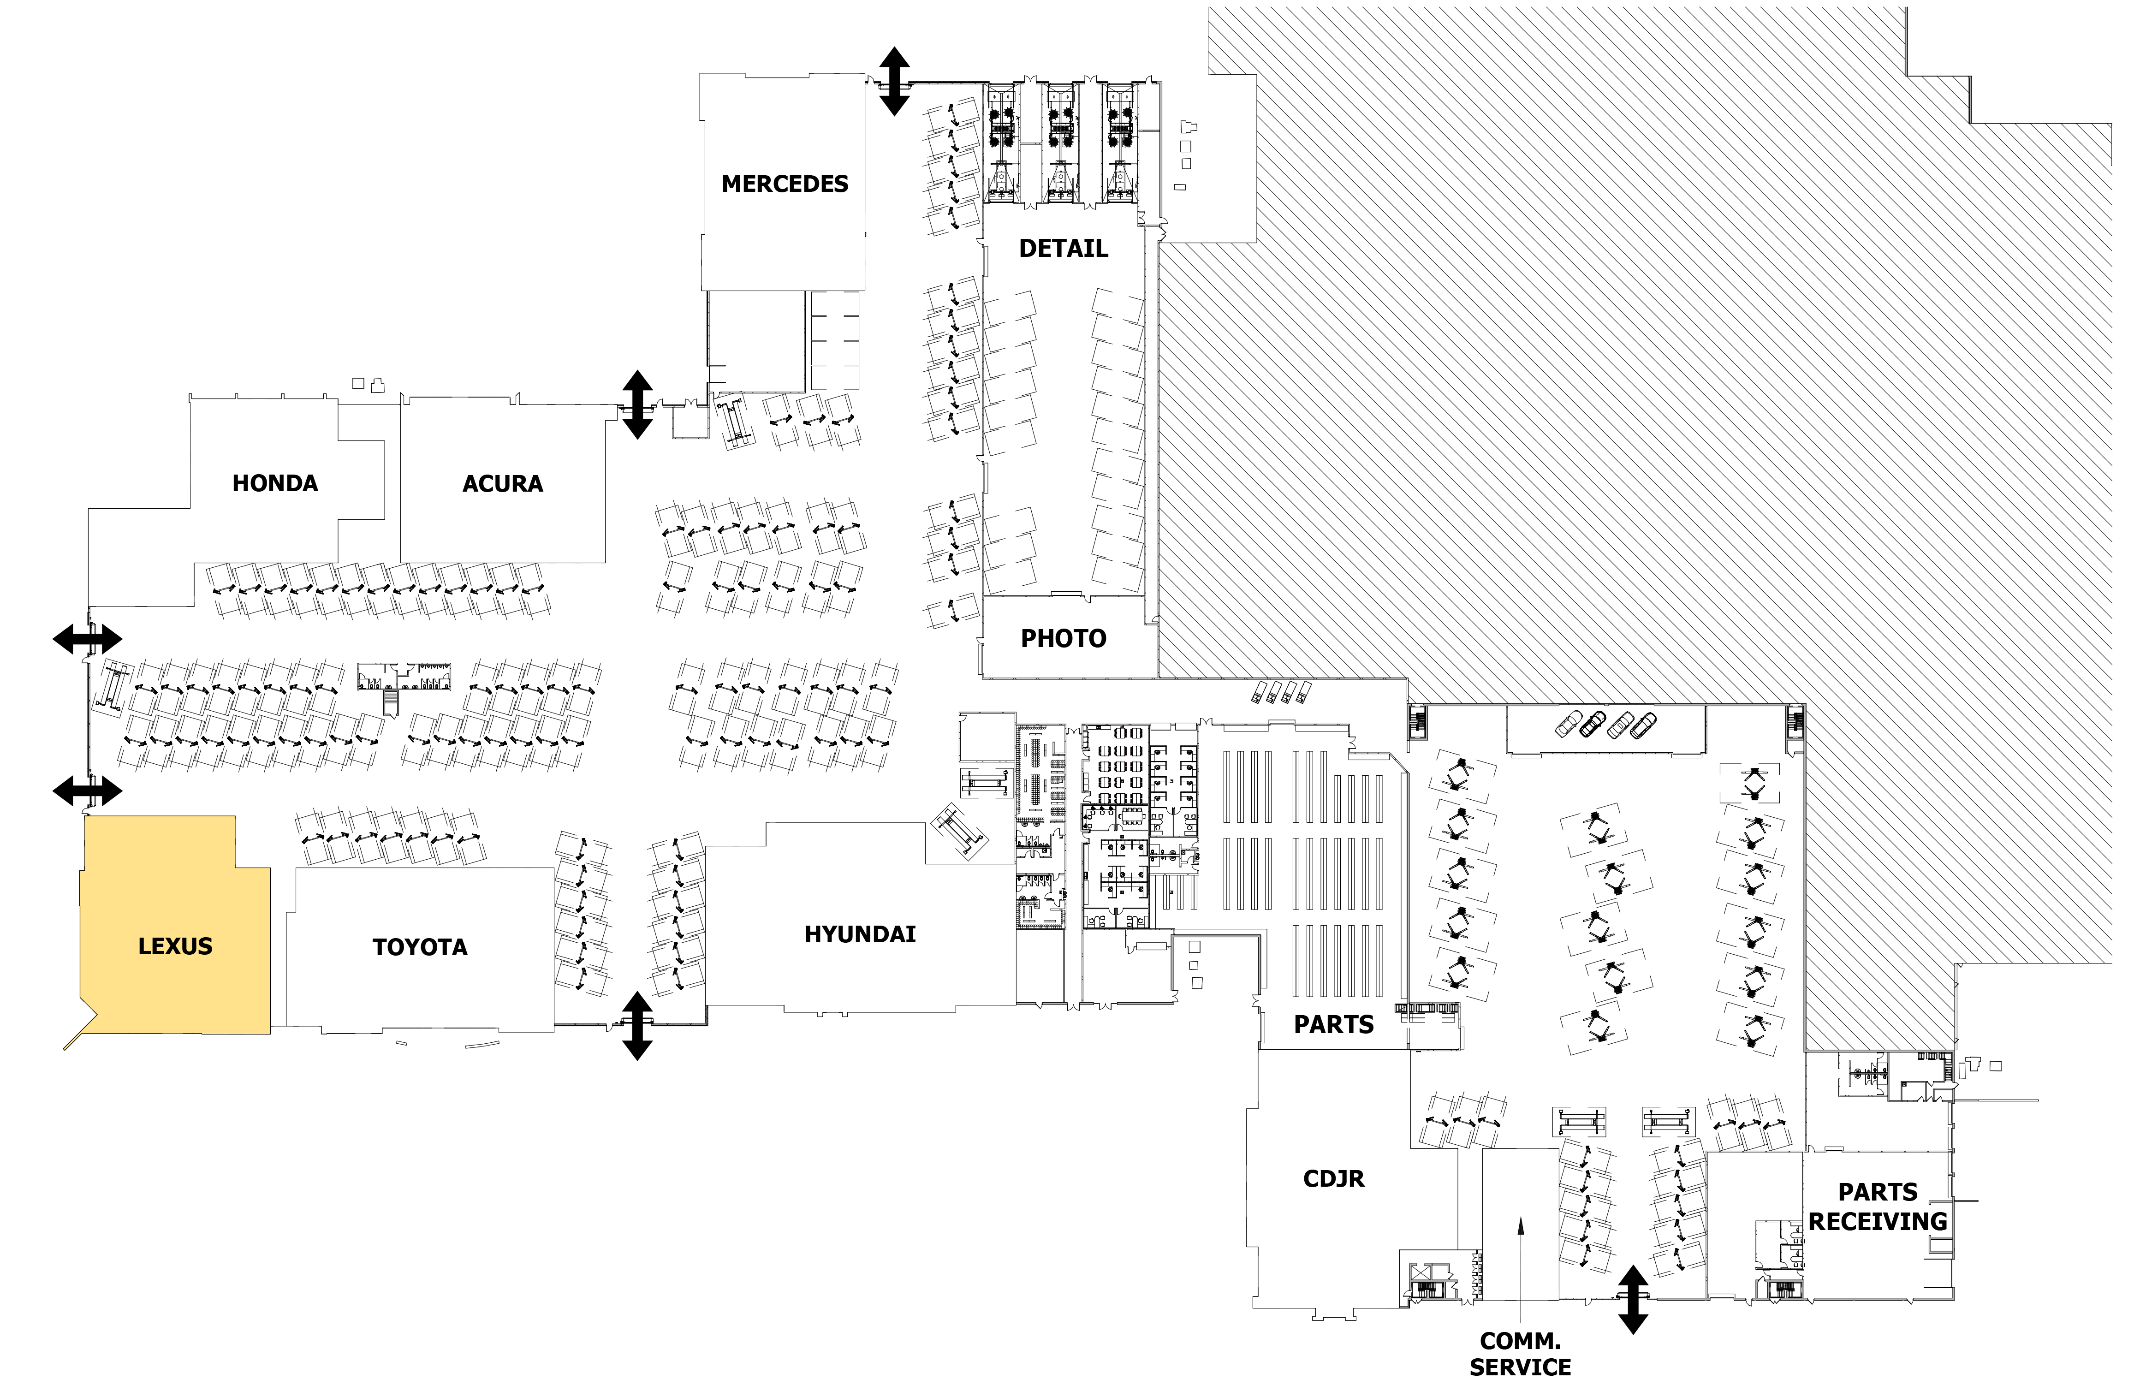
Service Floorplan Proposed
After
Service
Connected Sales and Service >
Dedicated Service Reception >
Dedicated Space for Service Advisors >
Sales & Service Lounge >

Slide 20
Sales & Service Façade Concept Proposed
Notes:
Need a rendering with the updated logo where you can see Sales and Service

Slide 21
Sales & Service Elevation Proposed

Slide 22
Thank You

